Slide 1
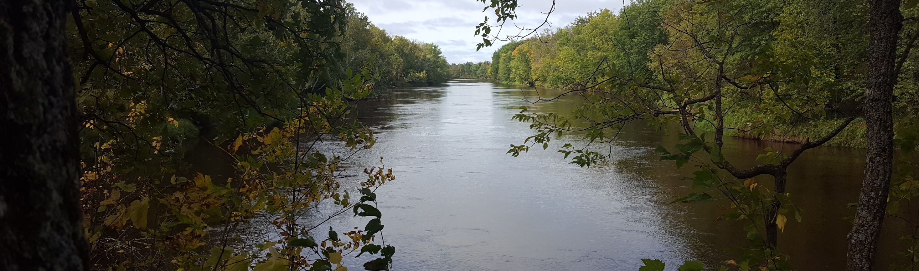
Mississippi Headwaters Board Biennial Conference
Closing Remarks
Photo credit: Jake Granfors, Pheasants Forever
John Jaschke
Executive Director
Minnesota Board of Water and Soil Resources (BWSR)

Slide 2
Minnesota Perspective
Value of partnerships & collaboration
SWCDs
Landowners
State & federal funding
BWSR
Joint Powers Orgs
Collaboration is essential to conservation implementation in Minnesota
Notes:
JOHN SLIDE

Slide 3
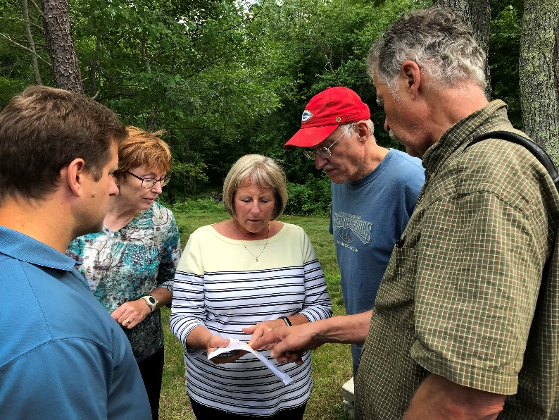
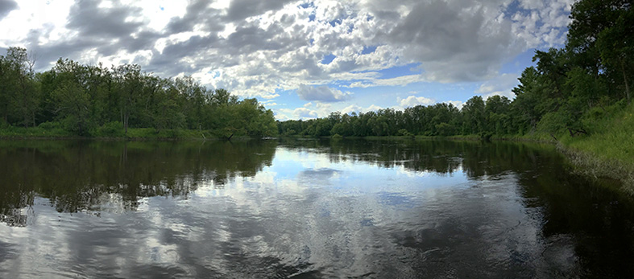
$10.9 million Outdoor Heritage Fund project
PARTNERS: MHB, BWSR, 8 SWCDS, Trust for Public Land
VOLUNTARY OPTIONS: RIM easements, fee title acquisitions.
BENEFITS: Wildlife habitat, recreation, metro area drinking water
Minnesota Perspective
Success story: Mississippi Headwaters Habitat Corridor Project (MHHCP)
Notes:
Story pdf for reference: https://bwsr.state.mn.us/sites/default/files/2019-03/Snapshots-Story-5-April-2019-MississippiHeadwaters%20CWF.pdf

Slide 4
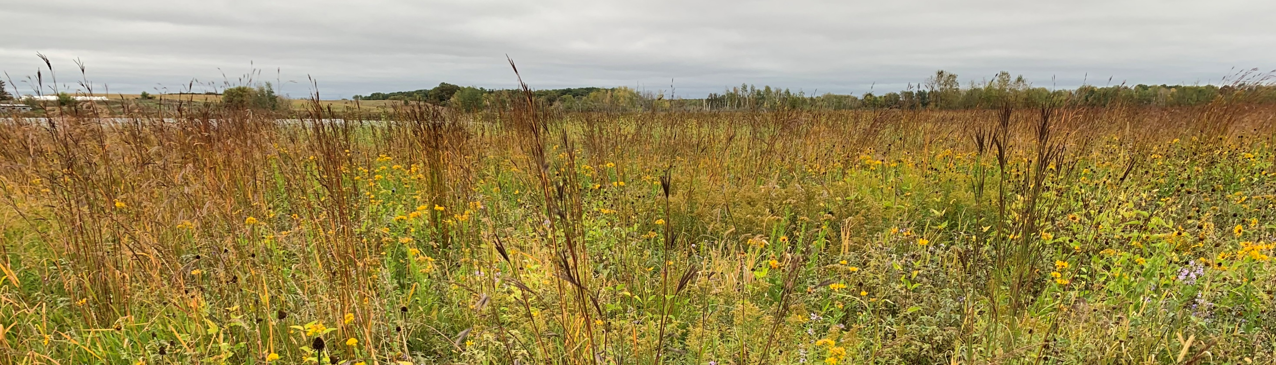
Reinvest in Minnesota (RIM) Reserve easements program

Slide 5
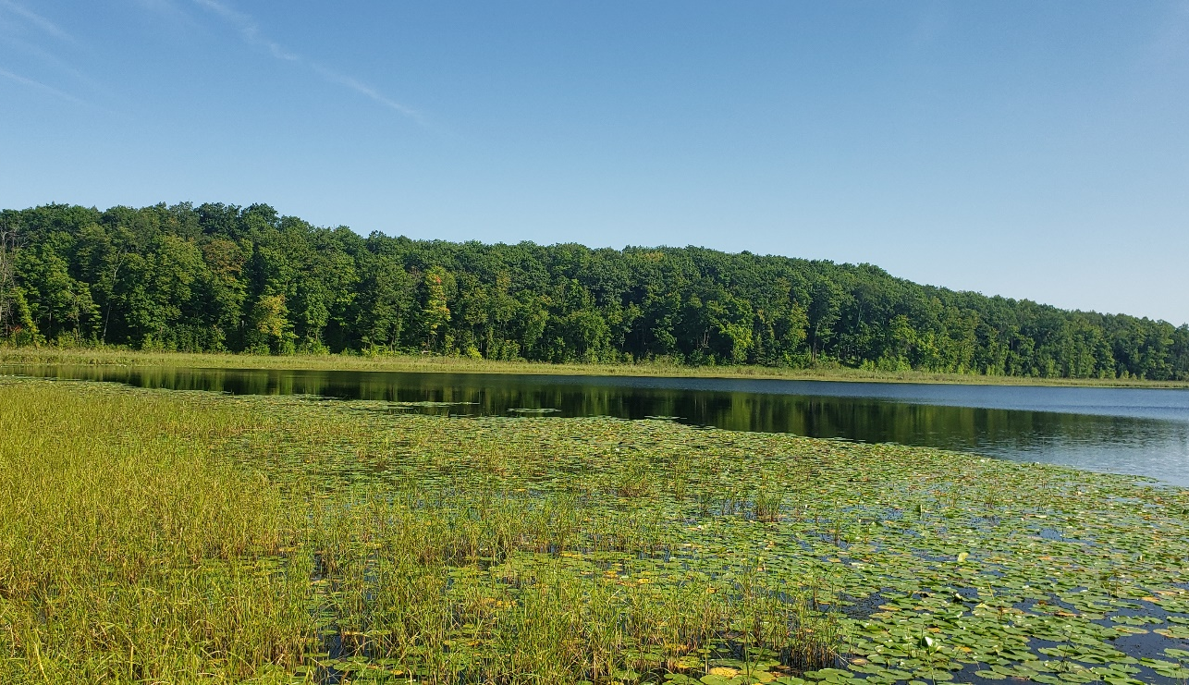
Reinvest in Minnesota (RIM) Reserve easements program
At a glance:
Program began in 1986
More than 7,000 easements
More than 300,000 acres protected to date

Slide 6
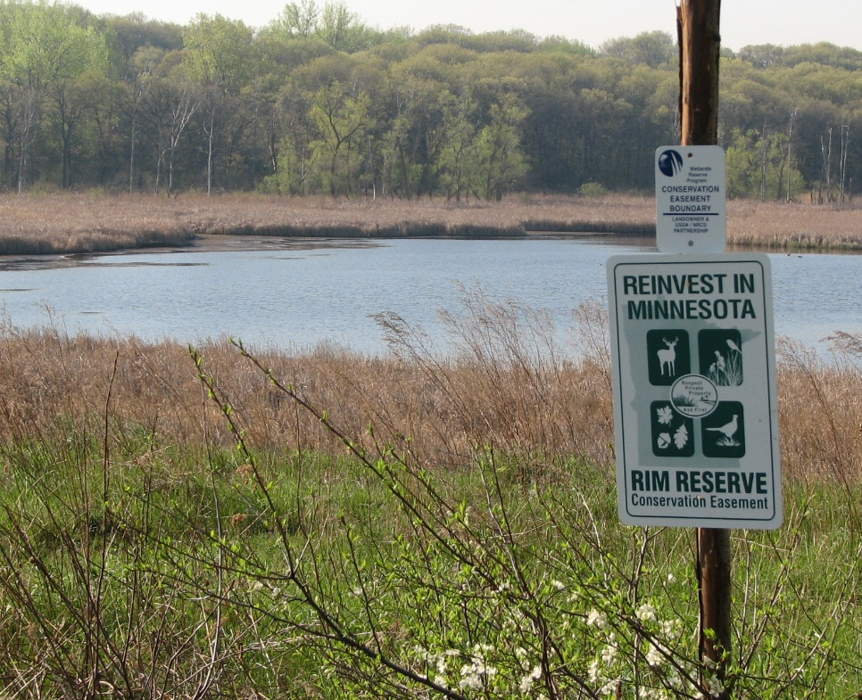
Currently funded RIM Initiatives (non-CREP)
Clean Water Fund + Other funding sources
Clean Water Fund
Critical Shorelands (Pine, Crow, Rum)
Wetlands (statewide)
Floodplain (buffers) (statewide)
Wellhead (statewide)
Working Lands pilot (bonding)
Protecting North Central MN Lakes (ENRTF) - Crow Wing and Aitkin counties

Slide 7
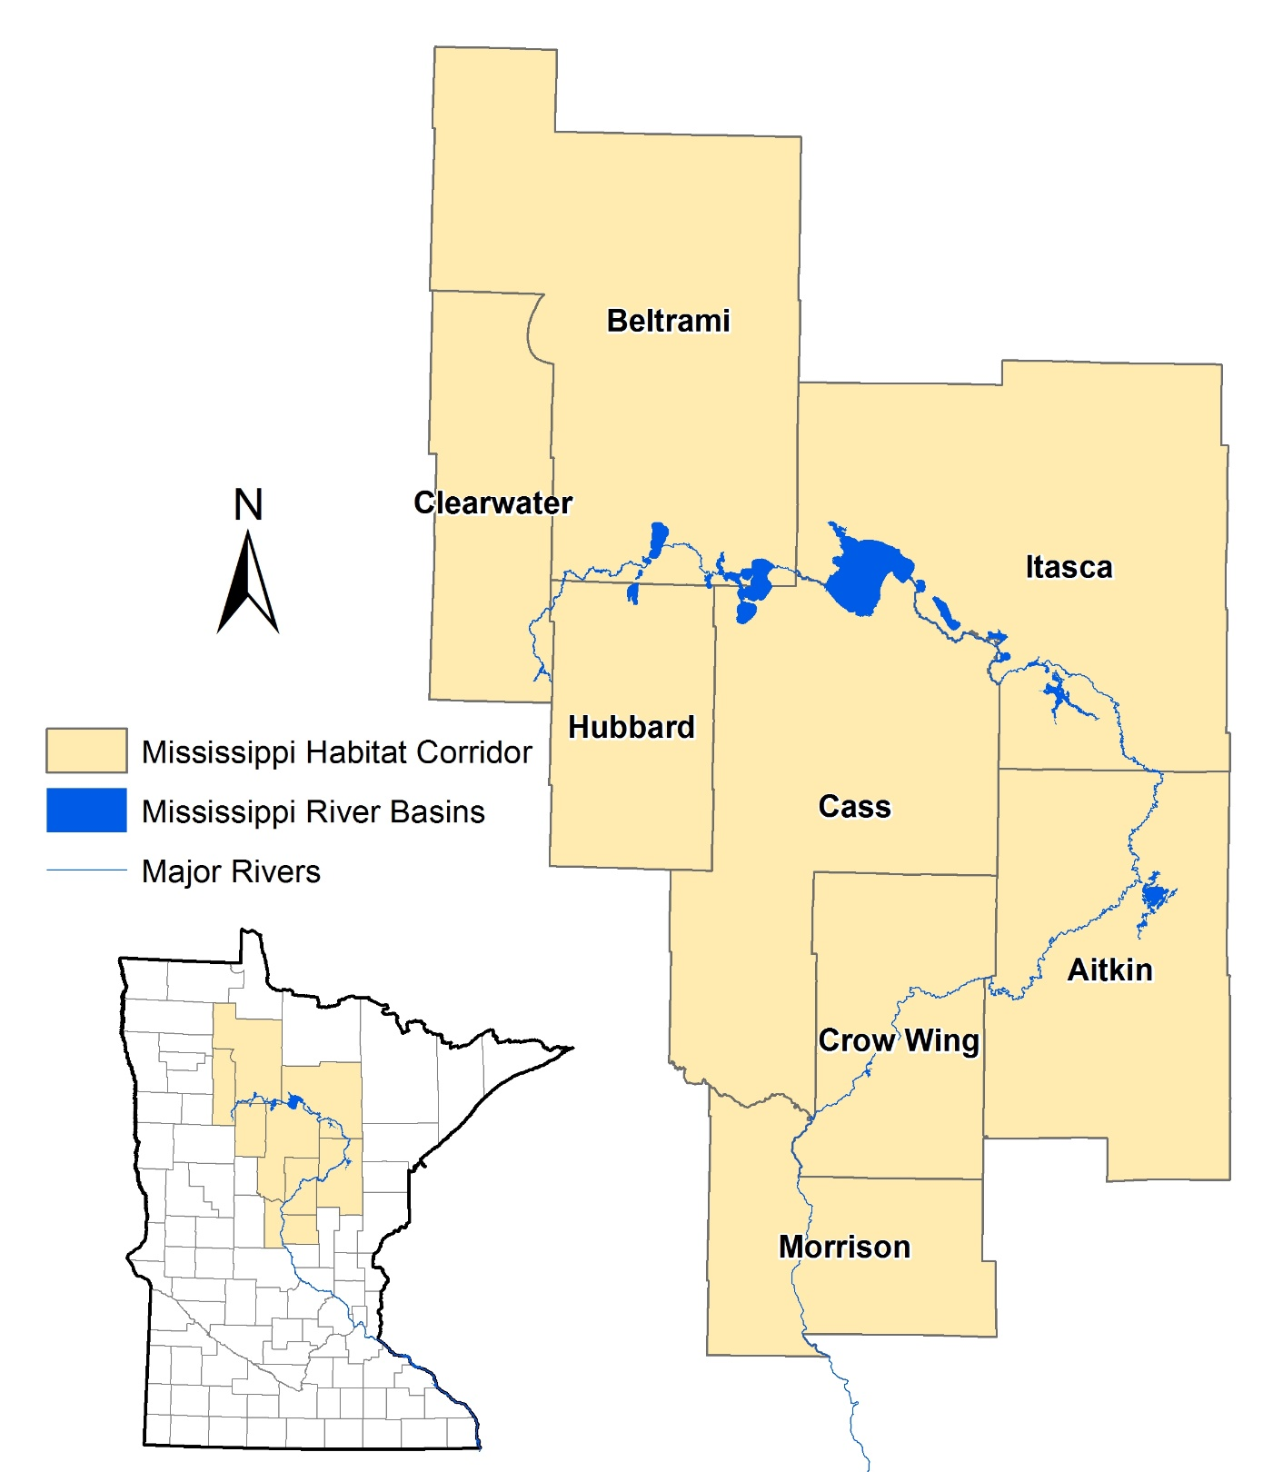
RIM in the Mississippi Headwaters
2016: Funding and partnerships began
46 easements
3,700 acres
Notes:
8 counties of MHB:

Slide 8
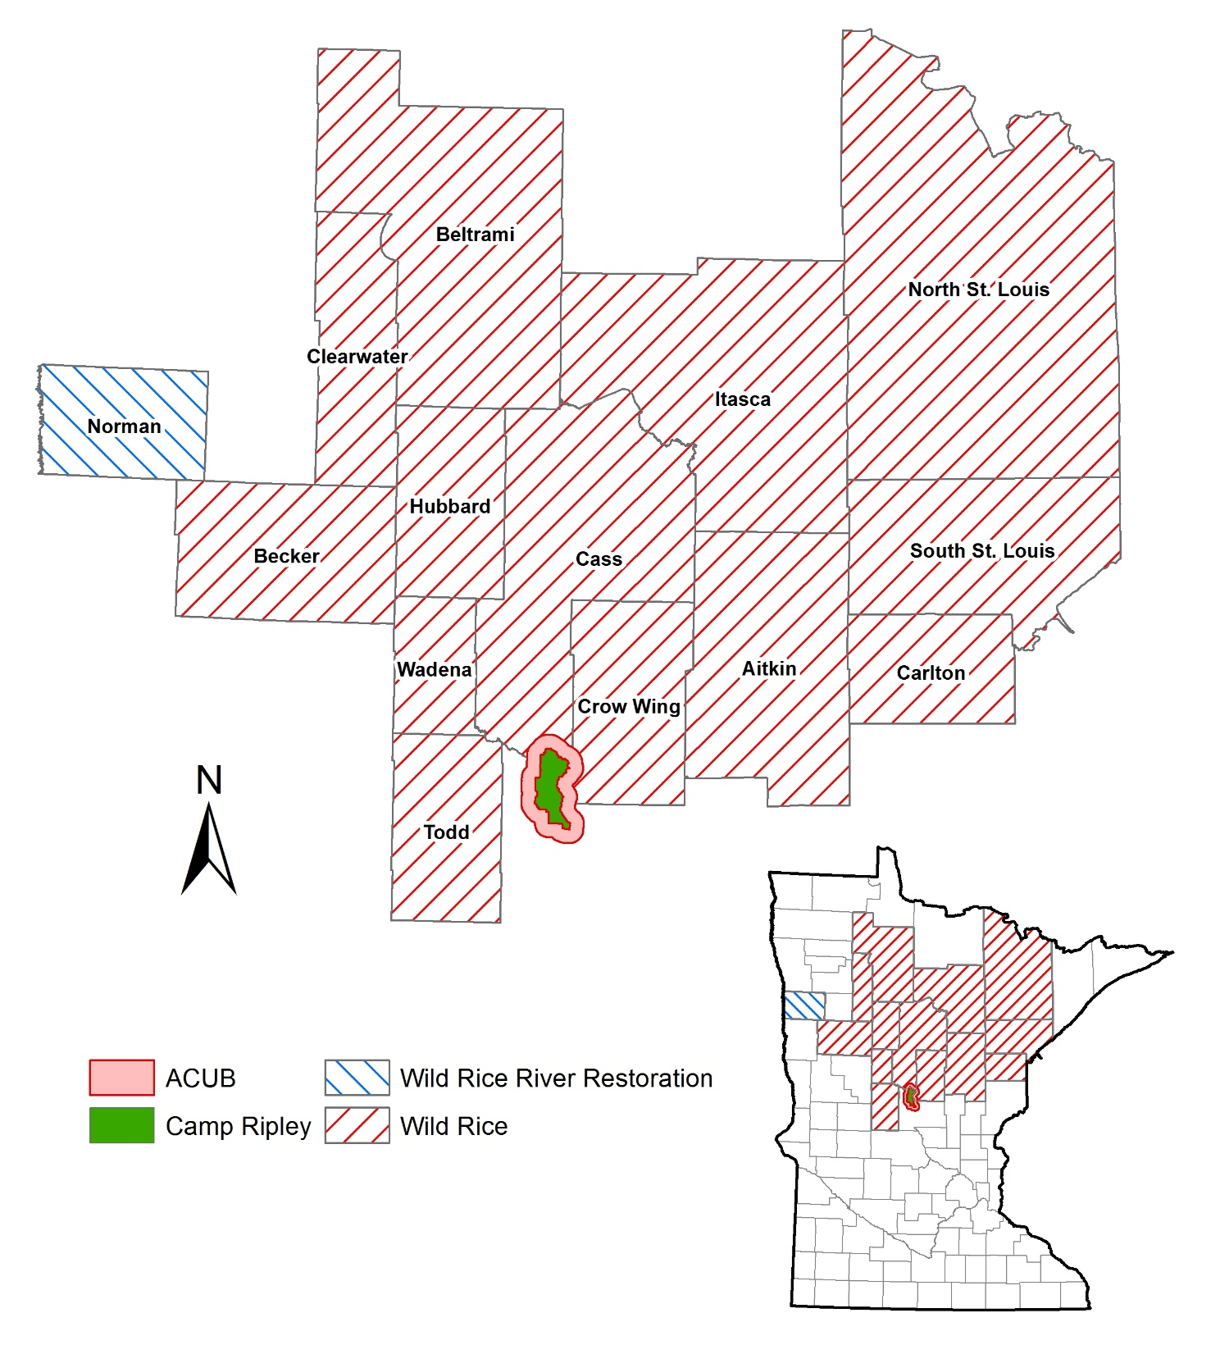
Wild Rice and ACUB
Army Compatible Use Buffer (ACUB)
Began in 2006
336 easements
33,000 acres
Wild Rice Shoreland
Began in 2013
76 easements
5,000 acres
Morrison
Cass
Crow Wing

Slide 9
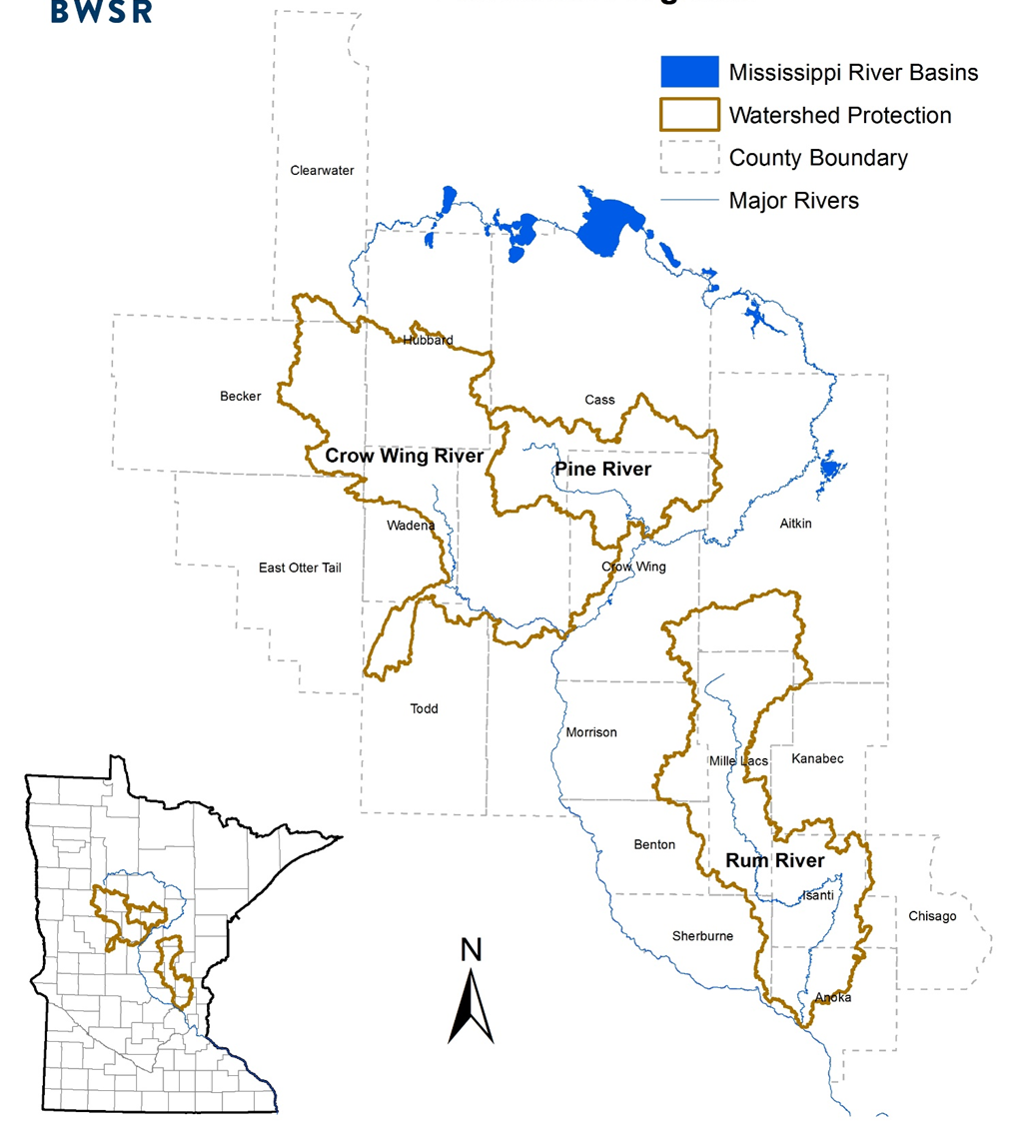
Northern RIM
Critical Shorelands
2015
40 easements
2,700 acres
Notes:
Critical Shorelands/Healthy Waters
CWF
Critical watersheds to protect the Mississippi as a drinking water source
Pine (Crow Wing, Cass and Aitkin), Crow Wing (CW, Cass, Morrison, Todd, Wadena, Hubbard, Becker, Clearwater, Otter Tail) and most recently – Rum River

Slide 10
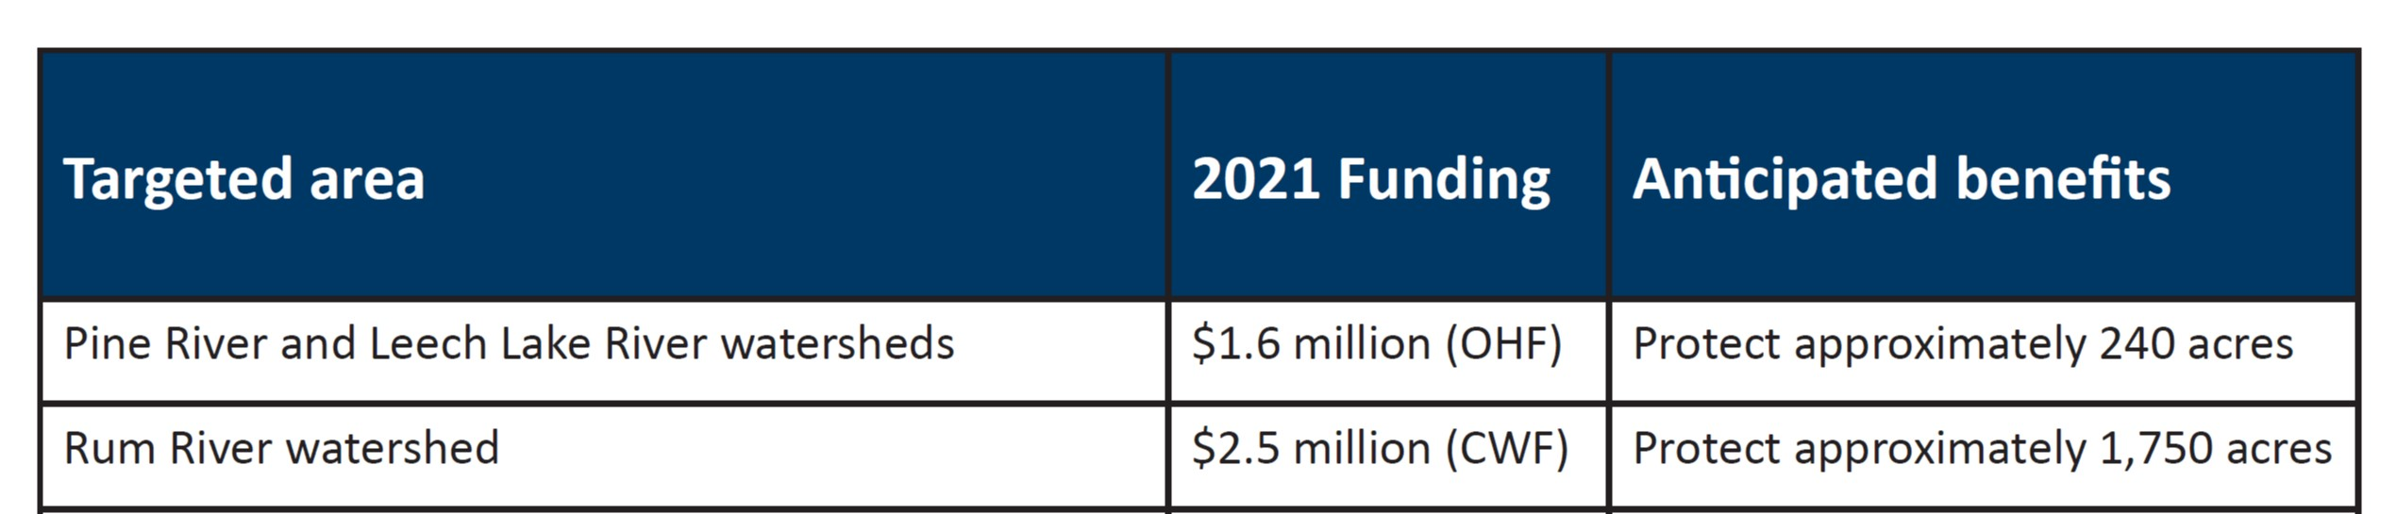
New OHF partner programs for 2021

Slide 11
New partner programs for 2021: Snake and Kettle River Protection
Includes parts of:
Aitkin County
Carlton County
Pine County
Kanabec County
Mille Lacs County
Snake River watershed
Kettle River watershed
Pine SWCD

Slide 12
New partner programs for 2021: Pine and Leech
Leech Lake River Partners:
Cass County
Cass SWCD
Hubbard County
Hubbard SWCD
Pine River Partners
Cass County
Cass SWCD
Crow Wing County
Crow Wing SWCD

Slide 13
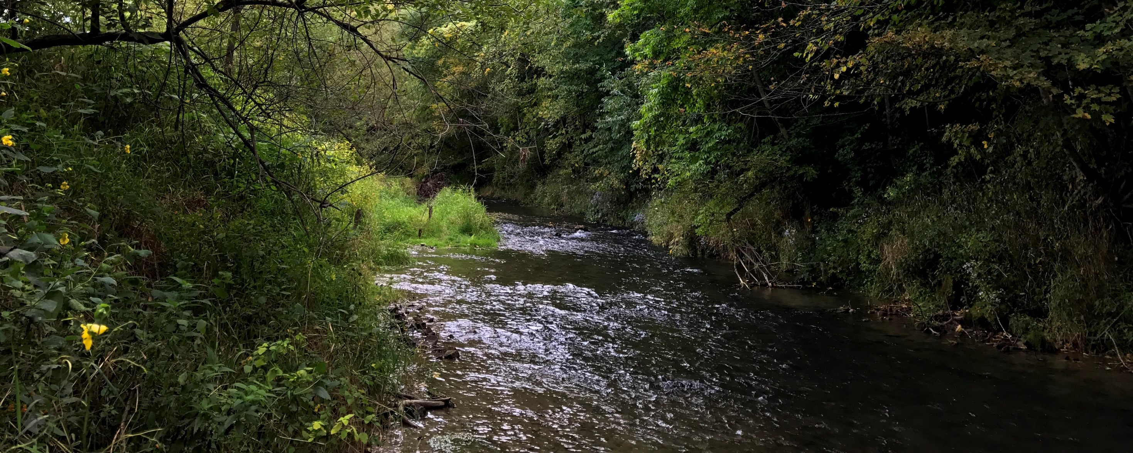
One Watershed, One Plan + Watershed-based implementation funding

Slide 14
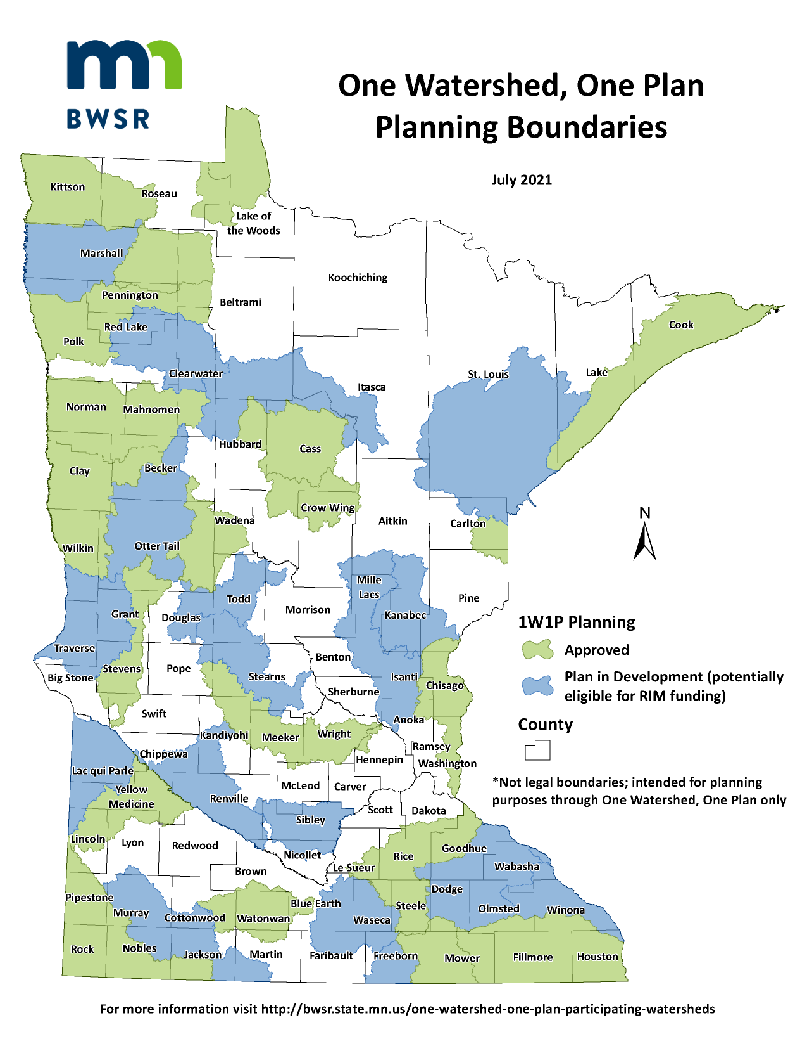

1W1P Participating Watersheds
Collaborating local governments develop comprehensive watershed management plans to ensure limited resources are spent where they are needed most within a watershed.

Slide 15
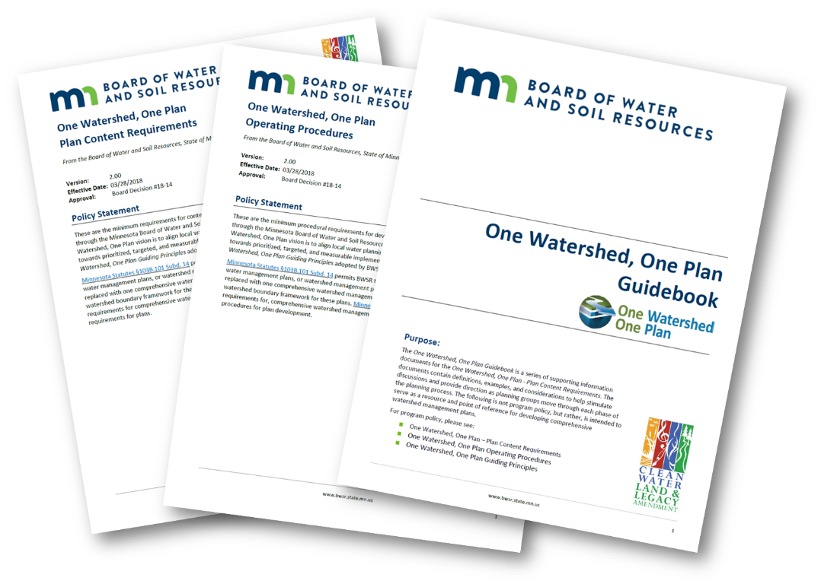
Minnesota Perspective
One Watershed, One Plan (1W1P)
49 total partnerships across the state (either in planning phase or with an approved plan)
Notes:
JOHN SLIDE

Slide 16
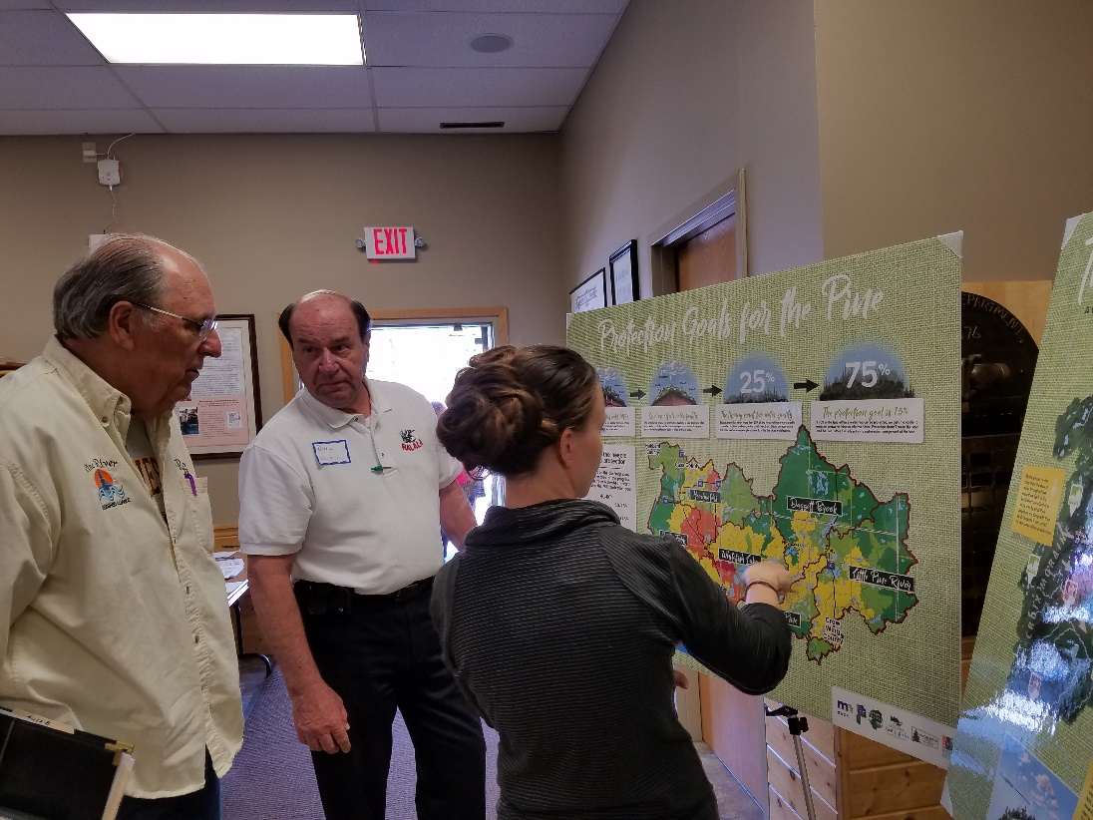
Minnesota Perspective
One Watershed, One Plan (1W1P)
25 partnerships in planning phase
Notes:
NOTE: This total reflects the latest totals following board action on 10/27/21

Slide 17
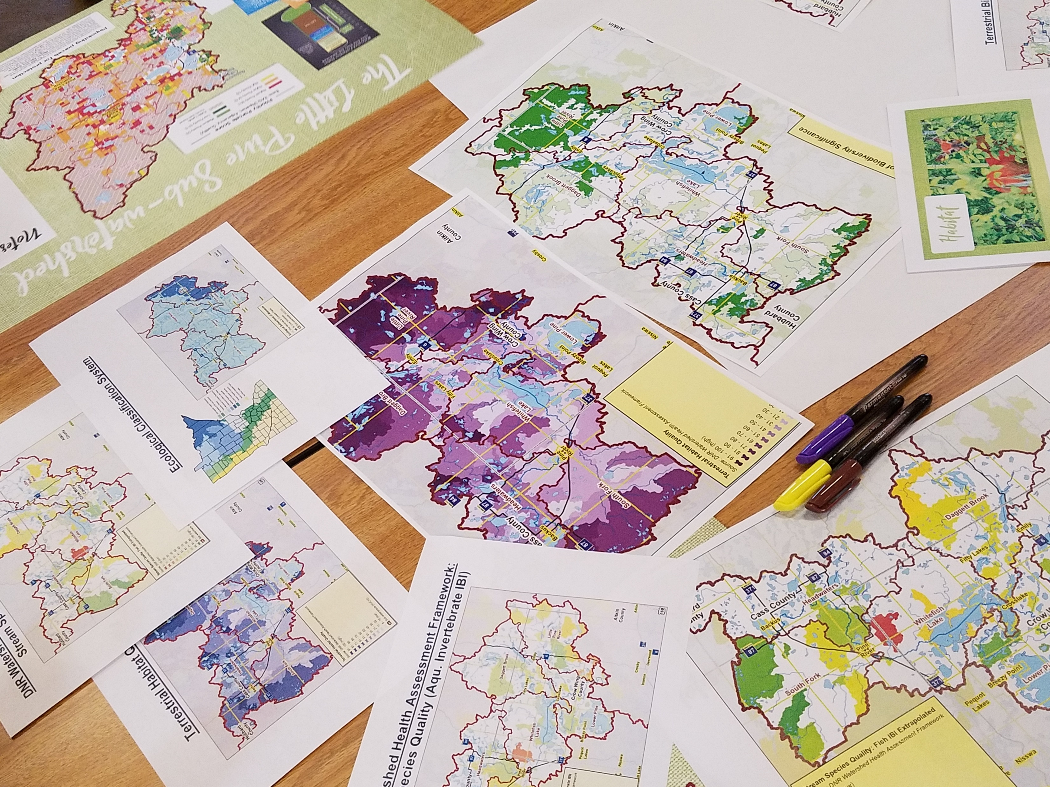
Minnesota Perspective
One Watershed, One Plan (1W1P)
24 approved comprehensive watershed management plans
Notes:
NOTE: This total reflects the latest totals following board action on 10/27/21

Slide 18
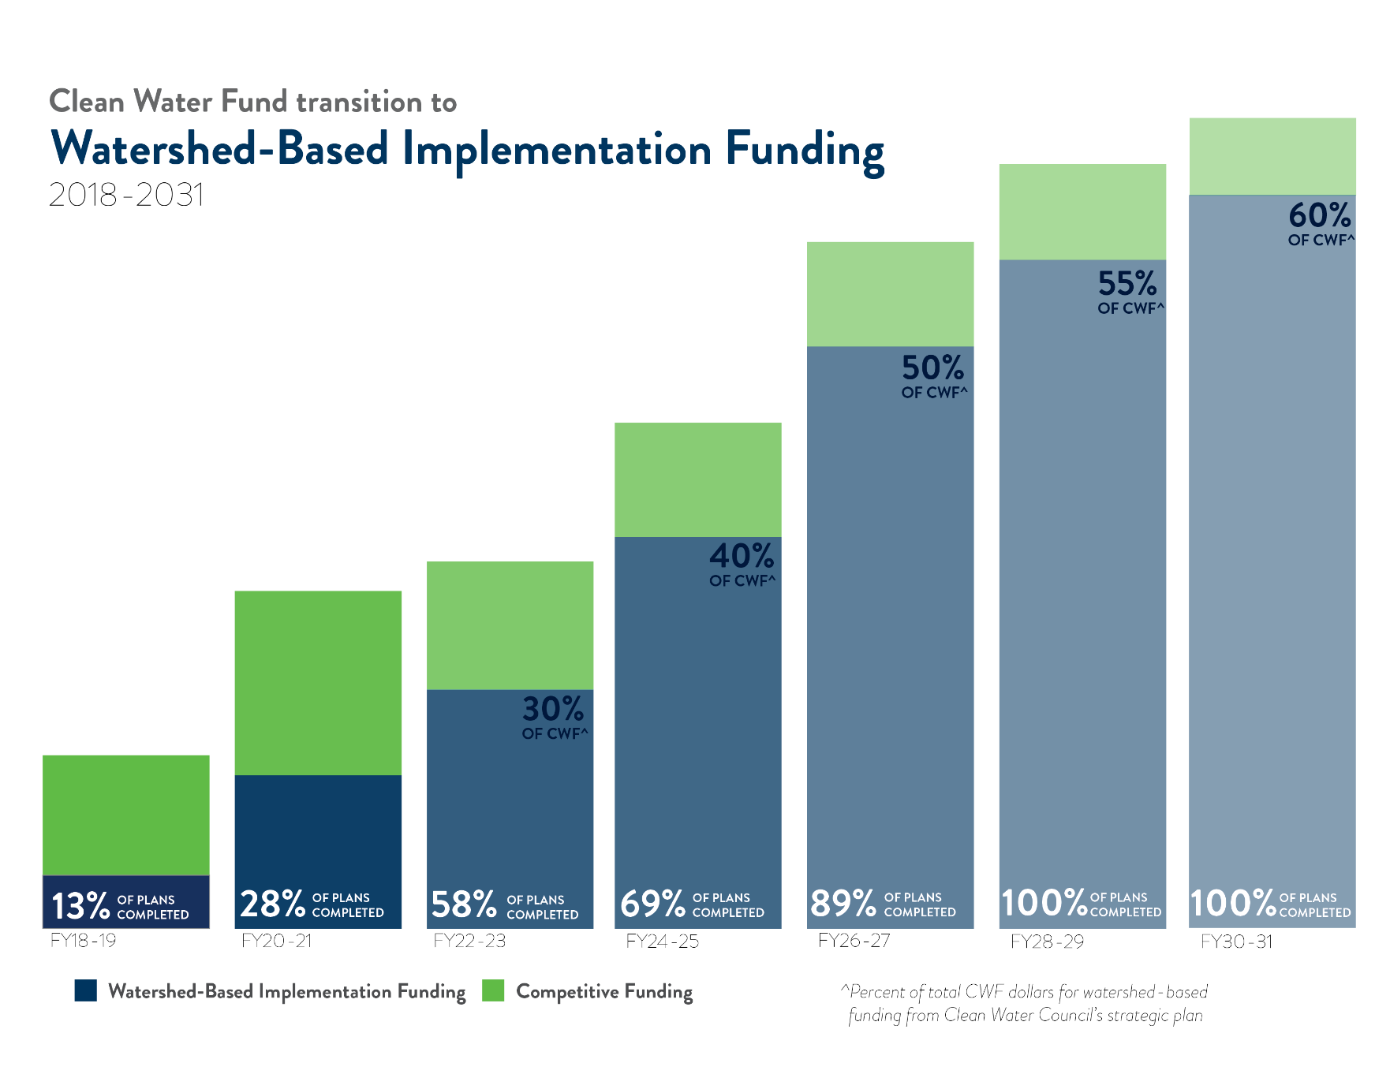
Minnesota Perspective
Watershed-based funding model
Notes:
J – Welcome Troy to Minnesota

Slide 19
Minnesota Perspective
Watershed-based implementation funding (WBIF)
Locally lead collaboration
Simplified administrative process
Known support for local water management
Prioritized, targeted, and measurable
Notes:
J – Welcome Troy to Minnesota

Slide 20
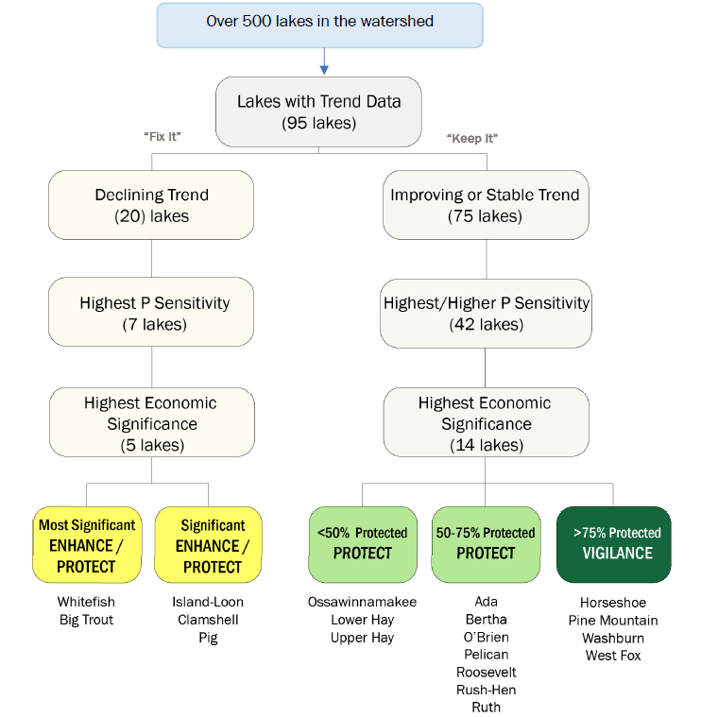
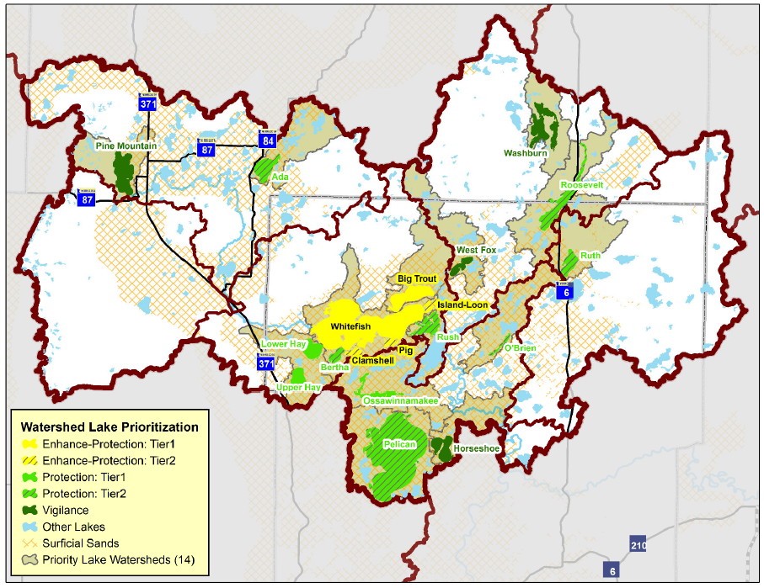
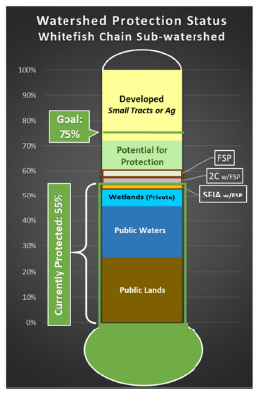
Efficient and Effective Use of Resources
Prioritize
Target
Measurable Goal
Notes:
Emphasize that PTM is the reason the funding for 1W1P and WBF are supported – we can show what we are planning and what we are accomplishing

Slide 21
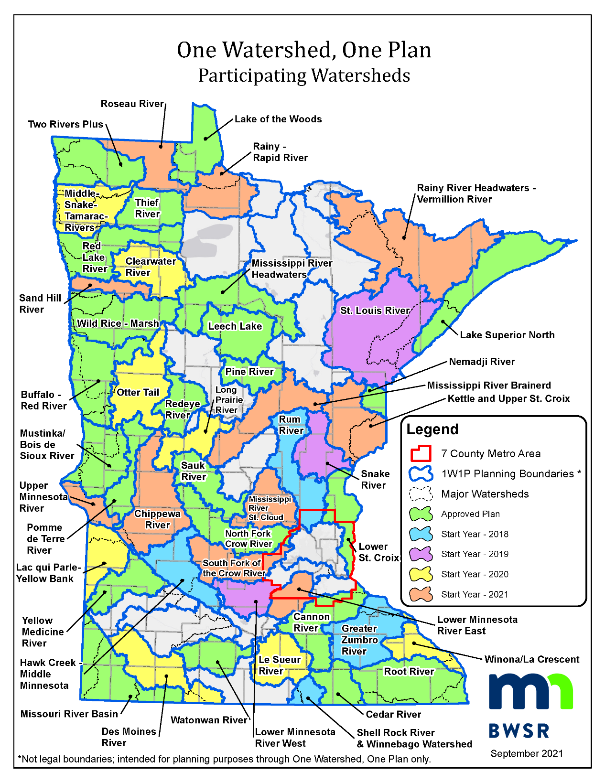
WBIF Statewide
September 2019: $24 million in WBIF approved for eligible partnerships
October 2021: $39.8 million in WBIF approved for eligible partnerships
Notes:
N

Slide 22
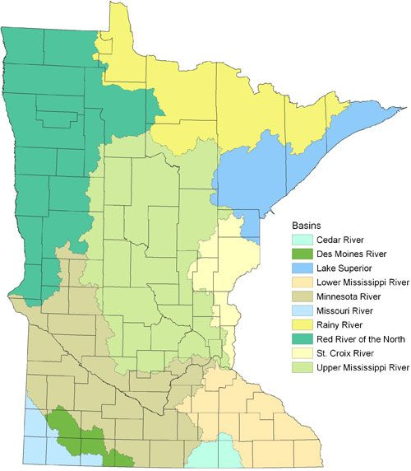
WBIF in the Mississippi Headwaters
Planning Boundary | Start Year | Plan approved? | WBIF amount
St. Louis River | 2019
Mississippi River - Headwaters | 2018 | X | $861,581
Leech Lake River | 2016 | X | $598,115
Pine River | 2017 | X | $482,142
Long Prairie River | 2020
Sauk River | 2017 | X | $832,550
Mississippi River - St. Cloud | 2021
Rum River | 2018
Kettle and Upper St. Croix River | 2021
Snake River | 2019
Otter Tail River | 2020
Marsh and Wild Rice River | 2018 | X | $1,371,259
Red Lake River | 2014 | X | $677,551 +$1,071,149
Thief River | 2016 | X | $529,892
Clearwater River | 2020
Roseau River | 2021
Rainy-Rapid River | 2021
Notes:
Emphasize that PTM is the reason the funding for 1W1P and WBF are supported – we can show what we are planning and what we are accomplishing

Slide 23

Minnesota Perspective
Partnership spotlight: Pine River 1W1P
Plan approved: September 2019
Watershed contains more than 500 lakes
Includes parts of Aitkin, Cass, Crow Wing and Hubbard Counties
Notes:
JOHN SLIDE

Slide 24
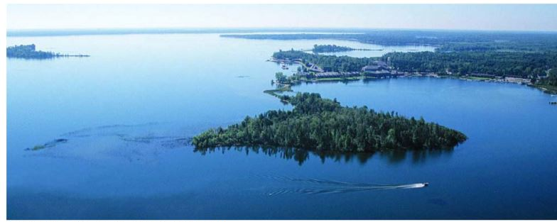
Pine River One Watershed, One Plan (1W1P)
Minnesota Perspective
Partnership spotlight (cont.)
Plan goals include:
Protecting forestland
Protecting DWSMAs
Reduce Phosphorus loading in surface water
Protecting forest cover
Water Quality
Notes:
JOHN SLIDE

Slide 25
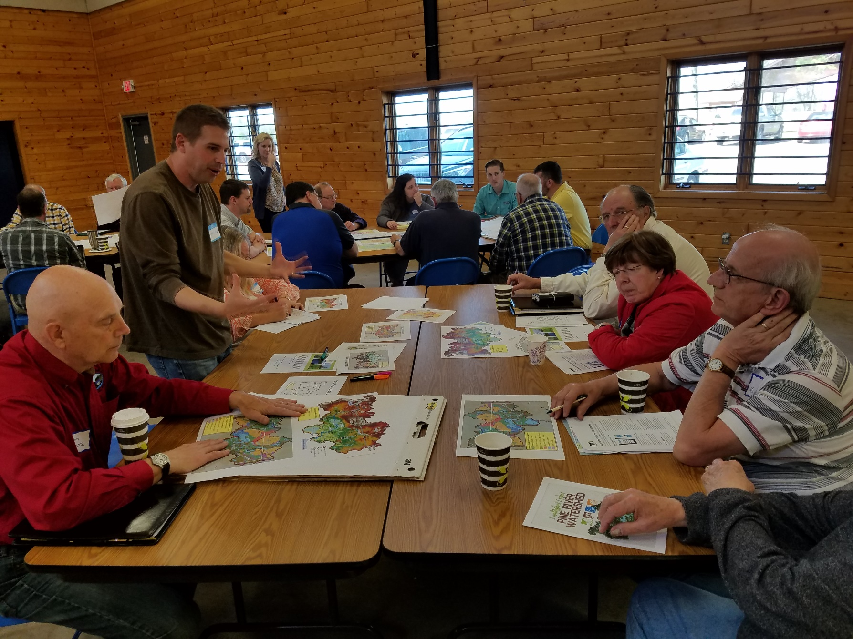
Plan completed under budget and ahead of schedule
Pine River watershed No. 1 out of Minnesota’s 81 watersheds for at-risk source water.
PARTNERS: Cass County, Cass SWCD, Crow Wing County, Crow Wing SWCD
Minnesota Perspective
Success story: Pine River 1W1P builds on past success
Notes:
Story pdf for reference: https://bwsr.state.mn.us/sites/default/files/2019-06/Snapshots-story-5-July-2019-PineRiver1W1P.pdf

Slide 26
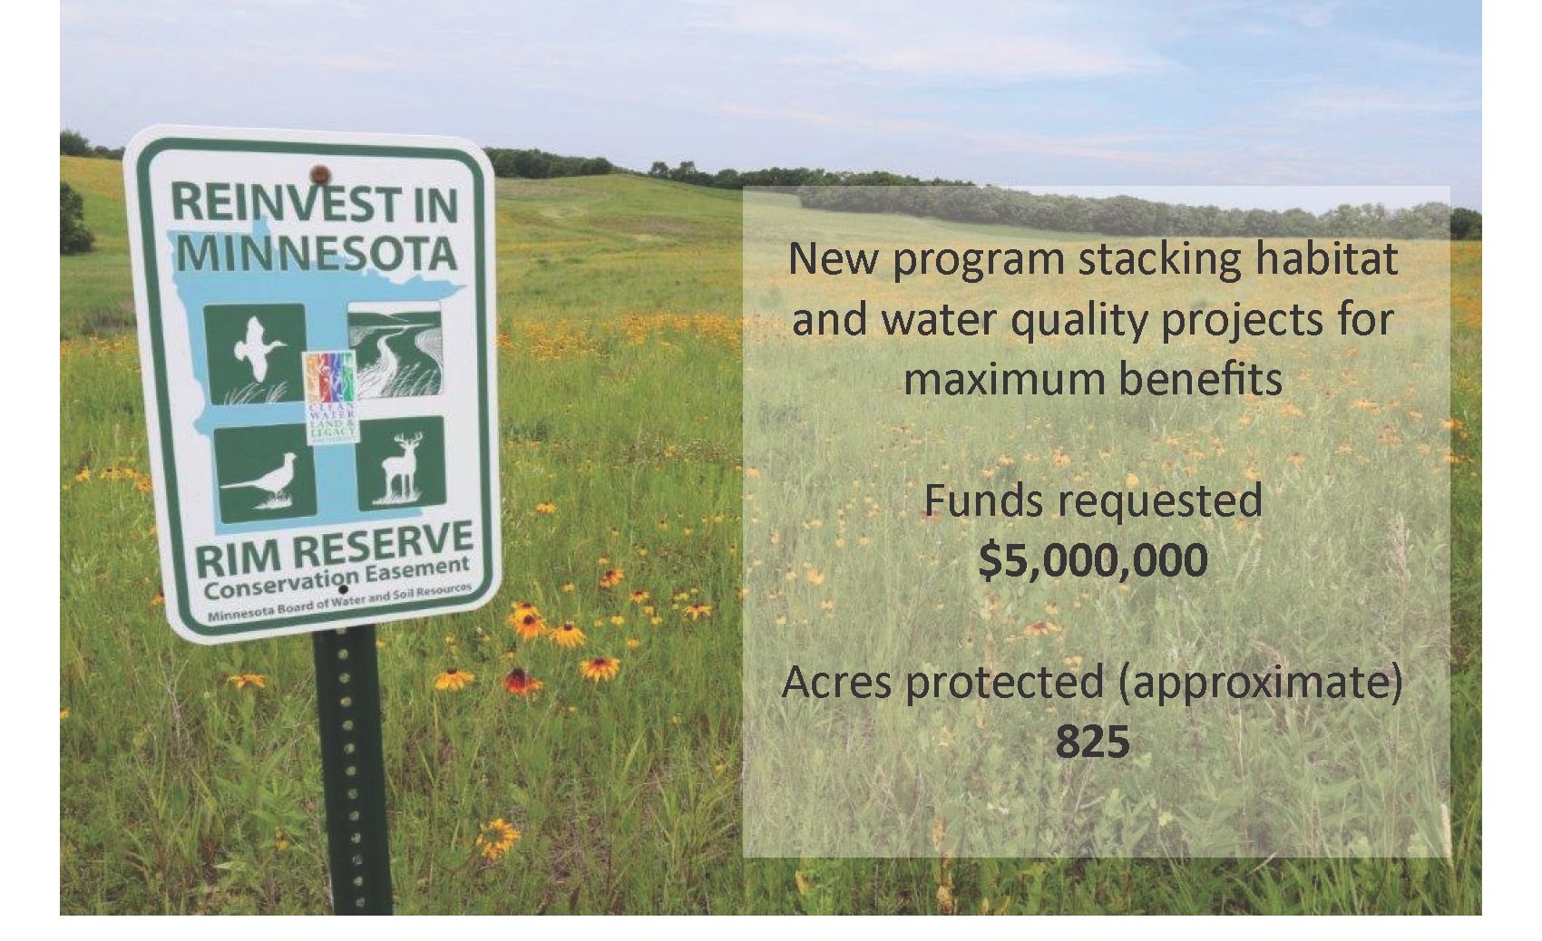
Minnesota Perspective
New LSOHC proposal: RIM + 1W1P
Outdoor Heritage Fund + Clean Water Fund dollars
Multiple benefits
Managers of both funds have expressed interest in achieving habitat and water quality goals simultaneously
Notes:
Story pdf for reference: https://bwsr.state.mn.us/sites/default/files/2019-06/Snapshots-story-5-July-2019-PineRiver1W1P.pdf

Slide 27
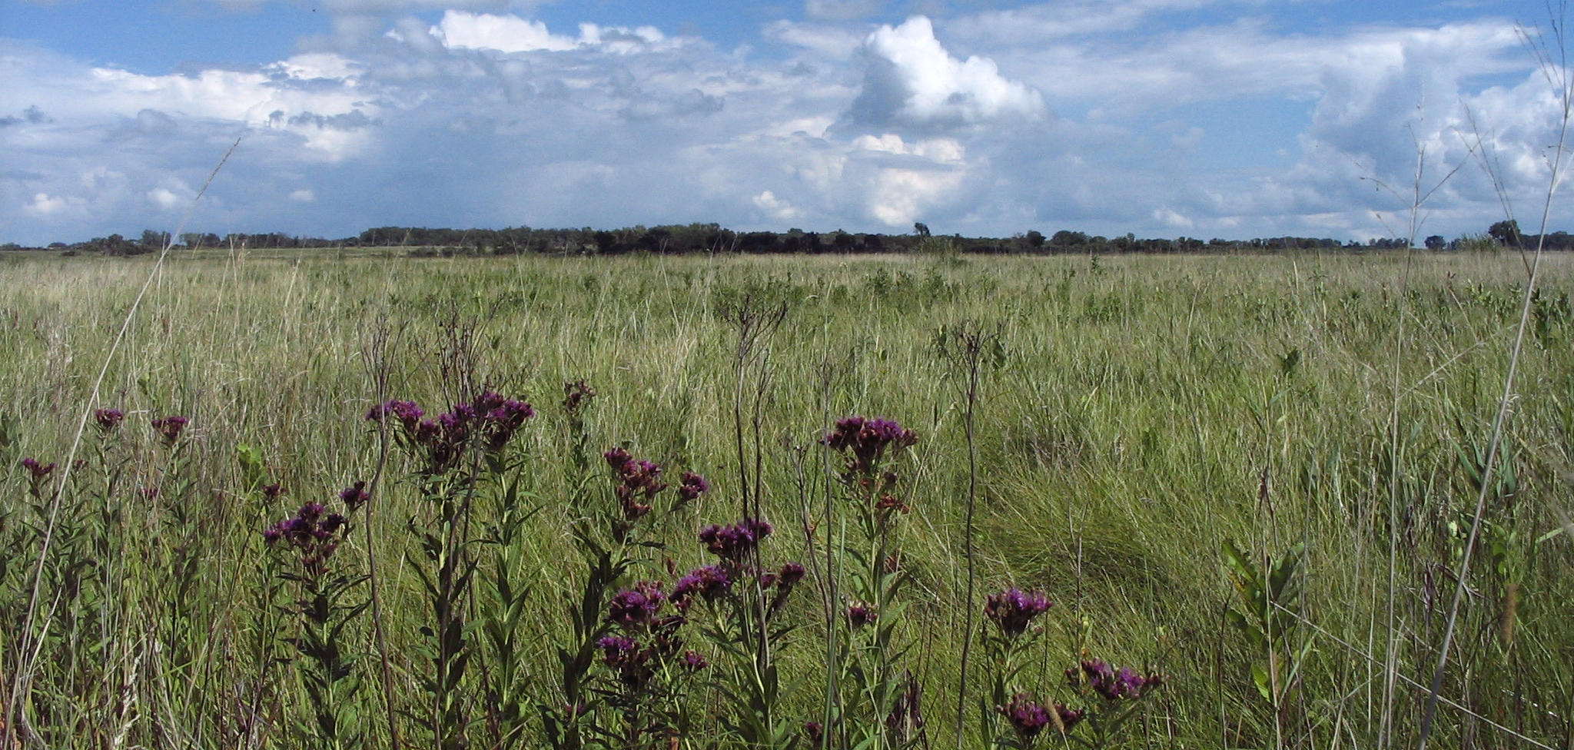
Thank you
John Jaschke
Executive Director, BWSR
John.Jaschke@state.mn.us
(651) 296-0878

